Slide 1
Lecture 13 probability and random variables

Slide 2
Review From Wednesday 2/23

Slide 3
Example:
The tiger trout is a sterile hybridization of a brown trout with a brook trout produced in fish hatcheries and stocked into ponds and lakes. It is a prized catch among fly fisherman. Suppose that of the 10,000 trout stocked in spring valley reservoir, 500 of them are tiger trout. Assuming that tiger trout and other species are homogeneously mixed:
what is the probability that I catch a tiger trout on my first cast?
What is the probability that I catch a tiger trout in my first 10 casts?

Slide 4
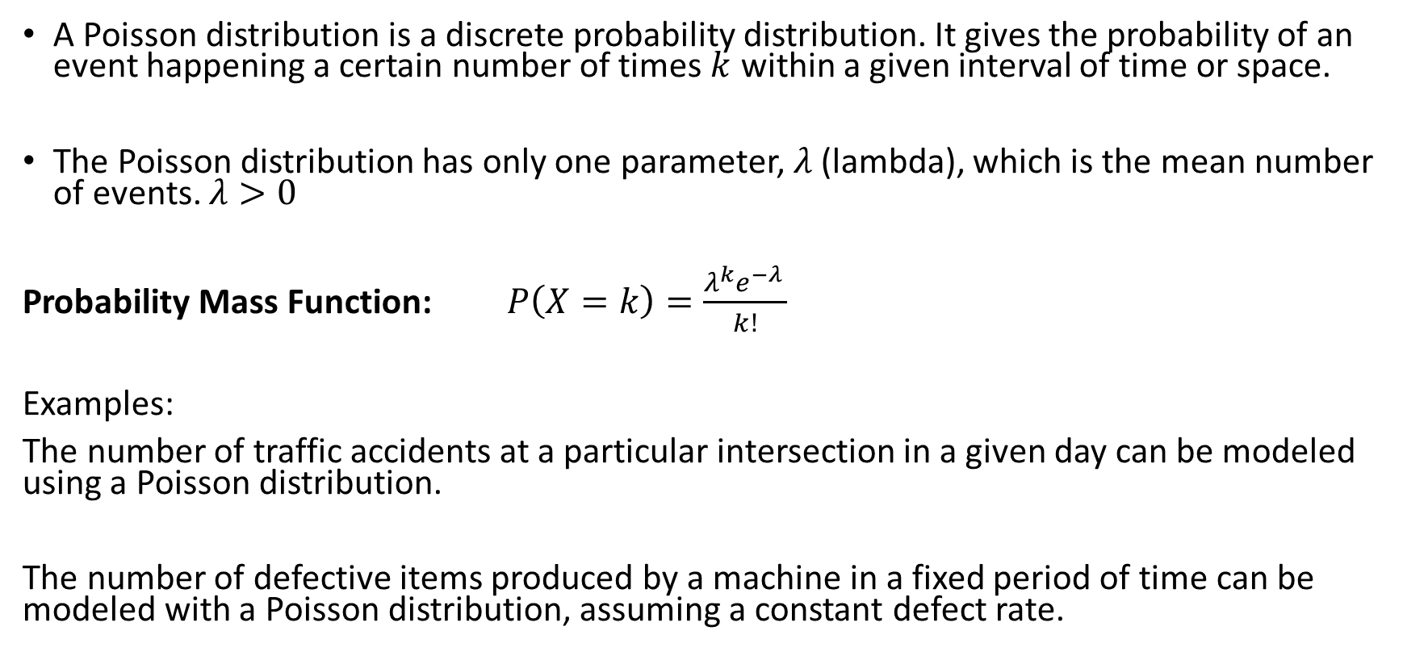
The Poisson Distribution
A Poisson distribution is a discrete probability distribution. It gives the probability of an event happening a certain number of times $k$ within a given interval of time or space.
The Poisson distribution has only one parameter, $λ$ (lambda), which is the mean number of events. $λ>0$
Probability Mass Function: $P\left(X=k\right)=\frac{λ^{k}e^{−λ }}{k!}$
Examples:
The number of traffic accidents at a particular intersection in a given day can be modeled using a Poisson distribution.
The number of defective items produced by a machine in a fixed period of time can be modeled with a Poisson distribution, assuming a constant defect rate.

Slide 5
Example:
Consider a scenario in the Star Wars universe where the number of rebel attacks on an Imperial outpost follows a Poisson distribution.
If the average rate of rebel attacks is 3.5 attacks per week, what is the probability of experiencing exactly 5 rebel attacks in a given week
What is the probability of experiencing less than 2 attacks in a given week?

Slide 6
Continuous Random Variables
Recall that a continuous random variable is a random variable with an uncountable number of values
Finding probabilities for continuous random variables requires a different mathematical treatment.
- we cannot simply list the possible values of a continuous random variable and their probabilities
The probability distribution of a continuous random variable is typically represented by a function, which we will usually consider graphically
- This function relates the value of the random variable to its probability density

Slide 7
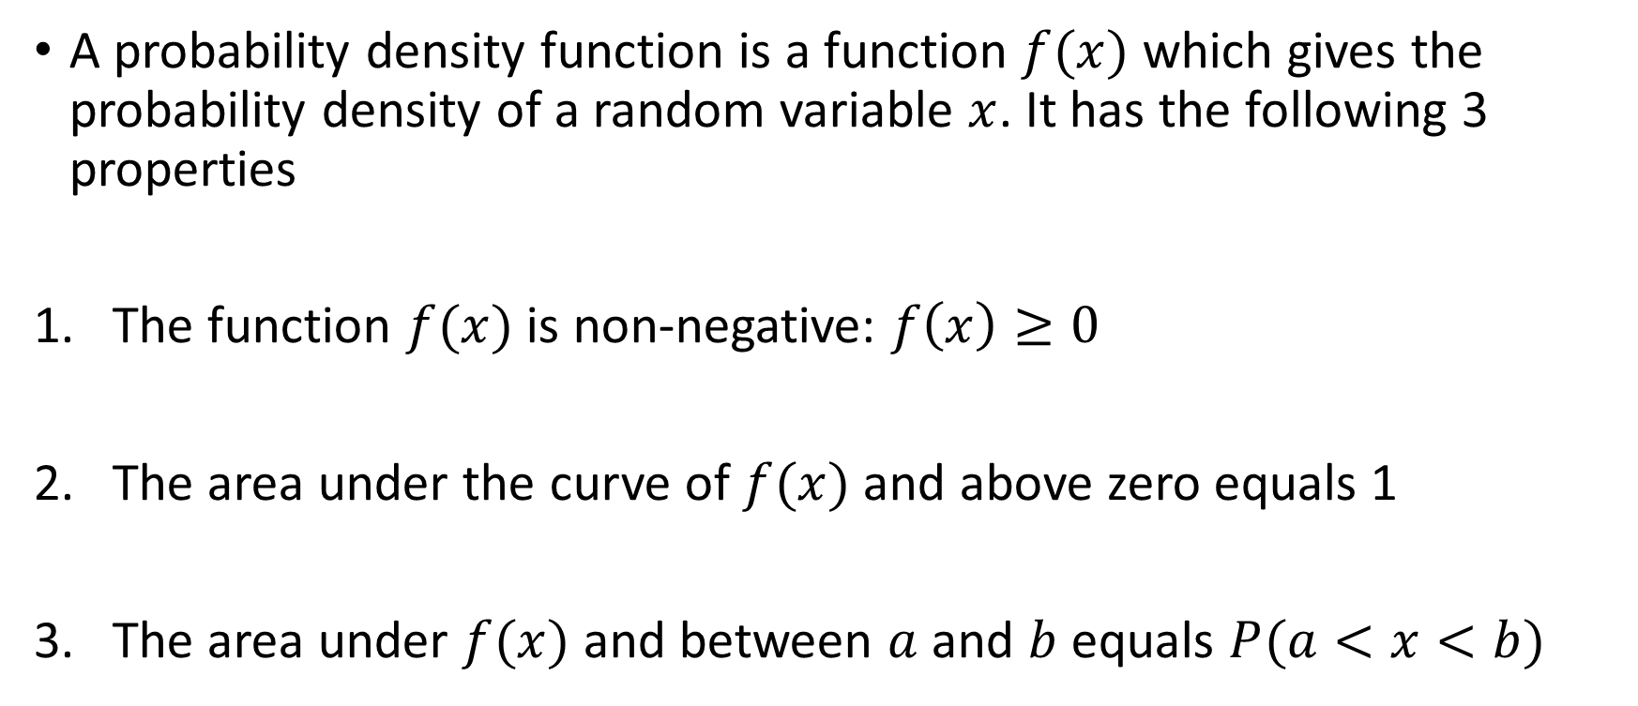
Probability Density Functions
A probability density function is a function $f(x)$ which gives the probability density of a random variable $x$. It has the following 3 properties
The function $f(x)$ is non-negative: $f\left(x\right)≥0$
The area under the curve of $f(x)$ and above zero equals 1
The area under $f(x)$ and between $a$ and $b$ equals $P(a<x<b)$

Slide 8
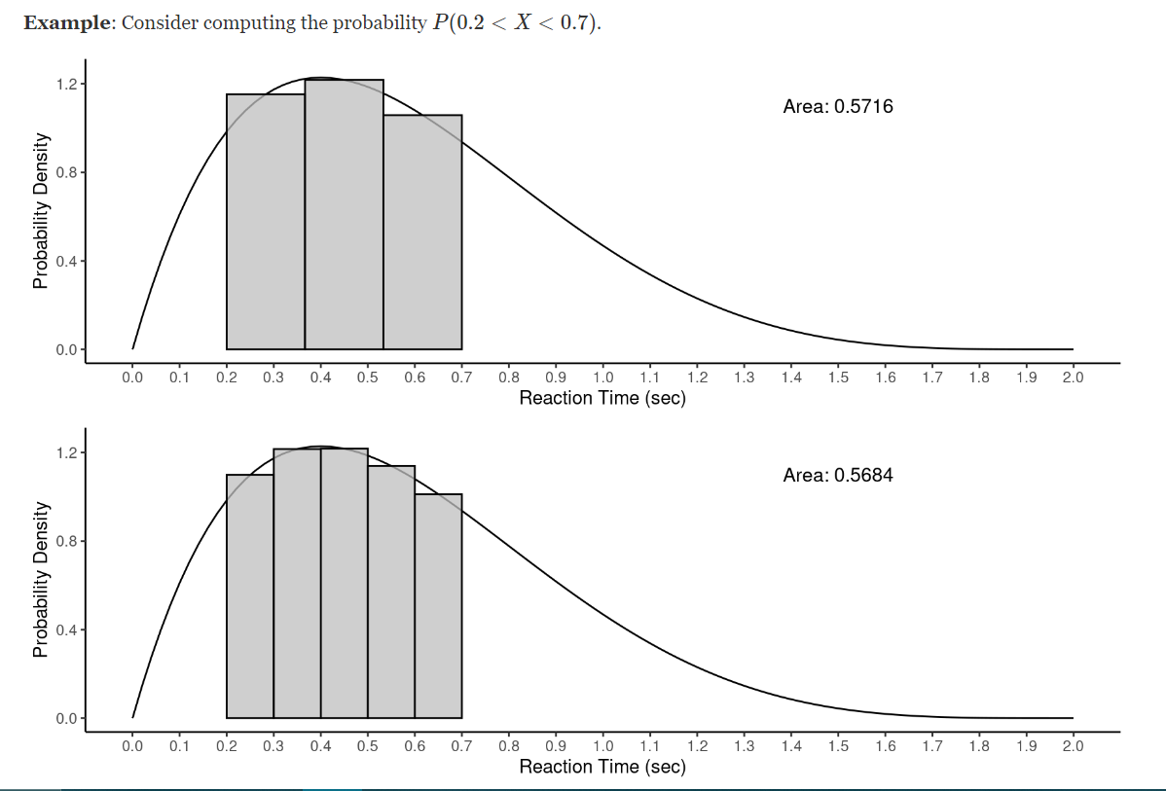
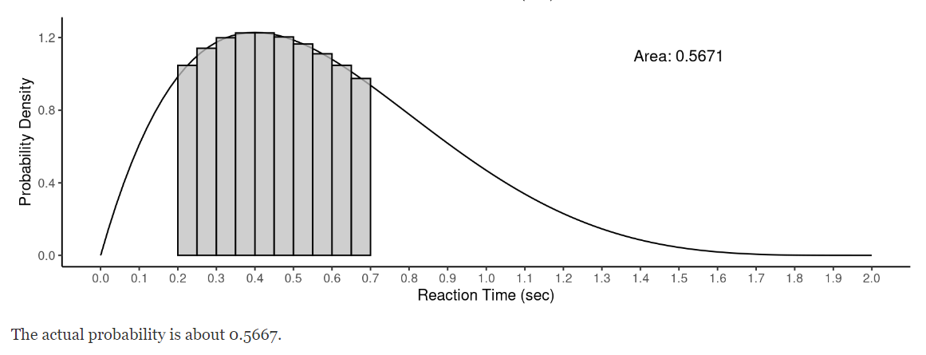
Approximating Probabilities of Continuous Distributions

Slide 9
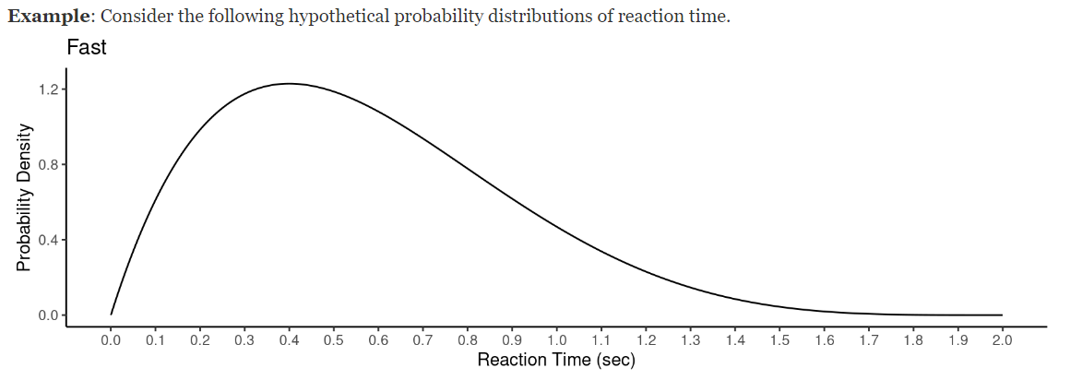
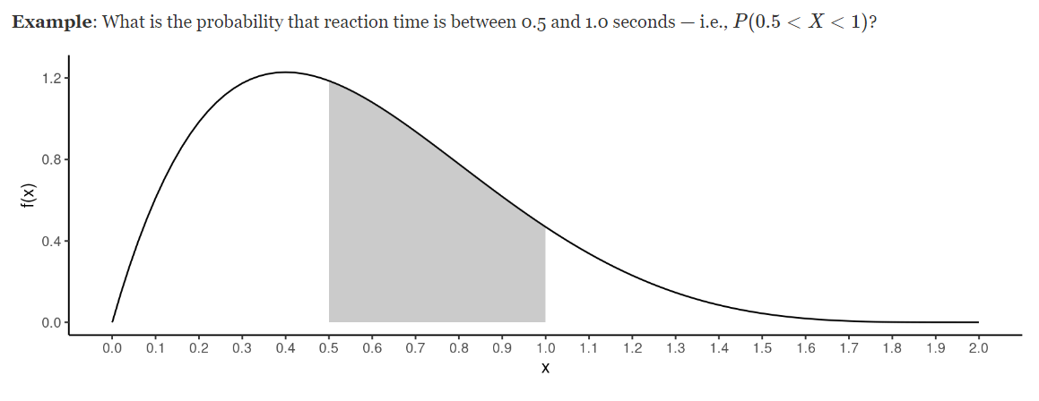

Slide 10
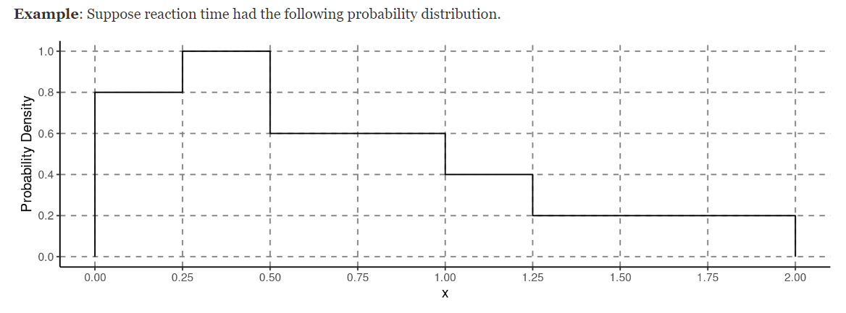
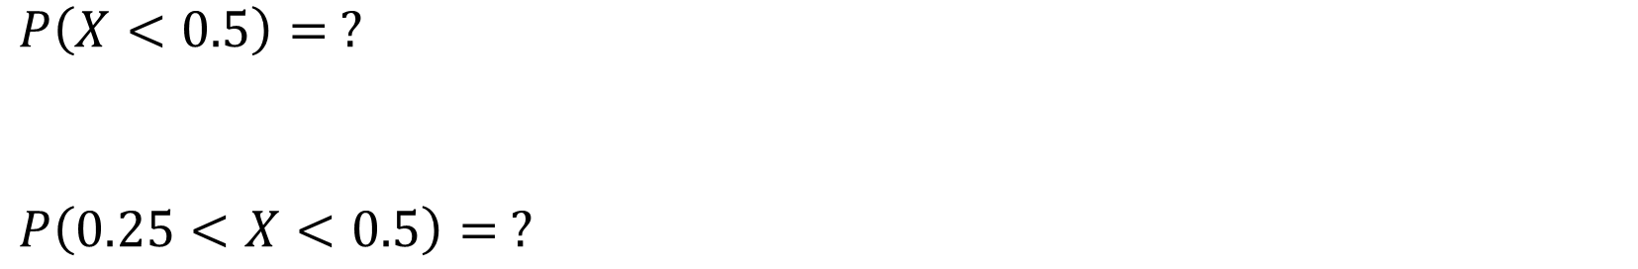
$P\left(X<0.5\right)= ?$
$$P\left(0.25<X<0.5\right)= ?$$

Slide 11
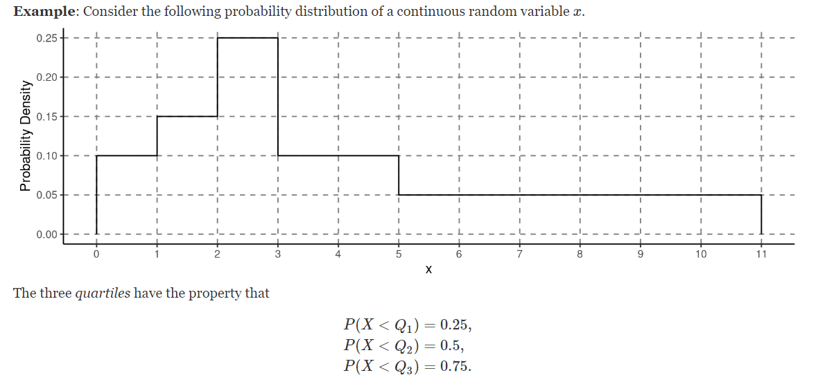
Quartiles

Slide 12
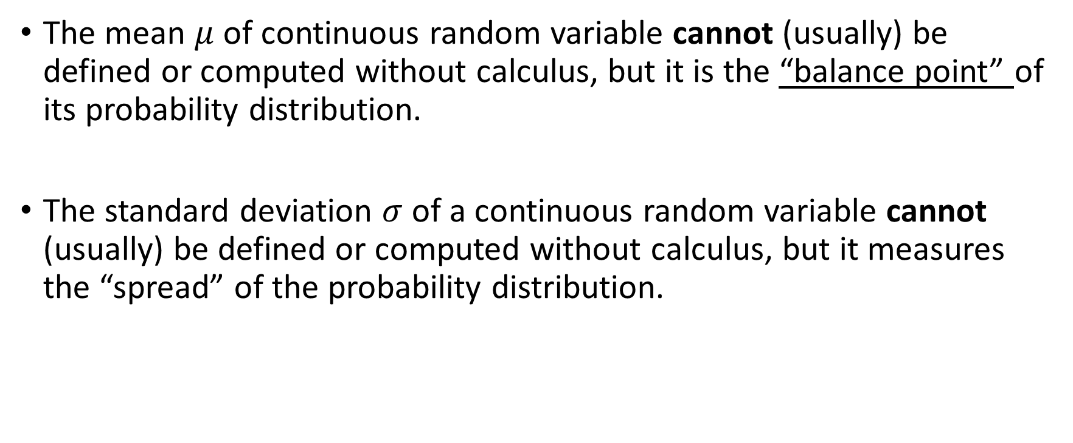
Mean and variance of Continuous Random Variables
The mean $μ$ of continuous random variable cannot (usually) be defined or computed without calculus, but it is the “balance point” of its probability distribution.
The standard deviation $σ$ of a continuous random variable cannot (usually) be defined or computed without calculus, but it measures the “spread” of the probability distribution.

Slide 13
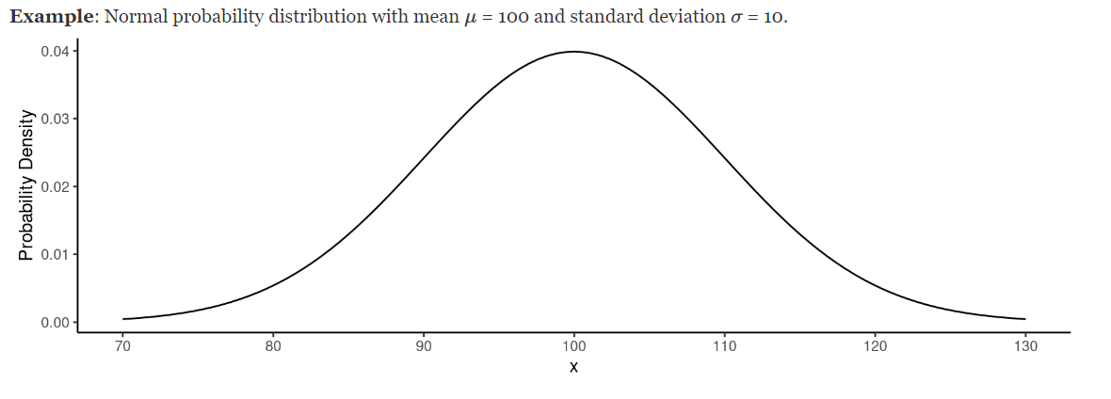
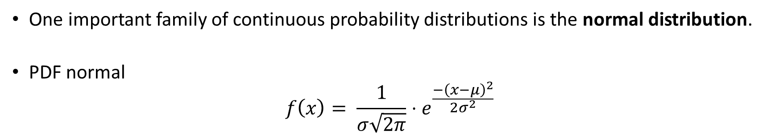
The Normal Distribution
One important family of continuous probability distributions is the normal distribution.
PDF normal
$$f\left(x\right)= \frac{1}{σ\sqrt{2π}}⋅e^{\frac{−{\left(x−μ\right)}^{2}}{2σ^{2}}}$$

Slide 14
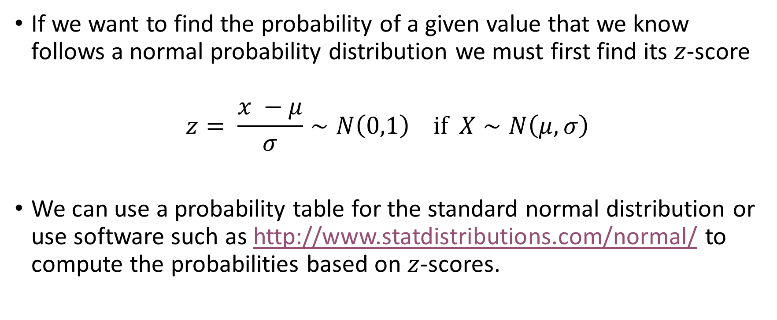
Computing Probabilities From A Normal Distribution
If we want to find the probability of a given value that we know follows a normal probability distribution we must first find its $z$-score
$$z= \frac{x −μ}{σ}∼N\left(0,1\right) if X∼N\left(μ, σ\right)$$
We can use a probability table for the standard normal distribution or use software such as http://www.statdistributions.com/normal/ to compute the probabilities based on $z$-scores.

Slide 15
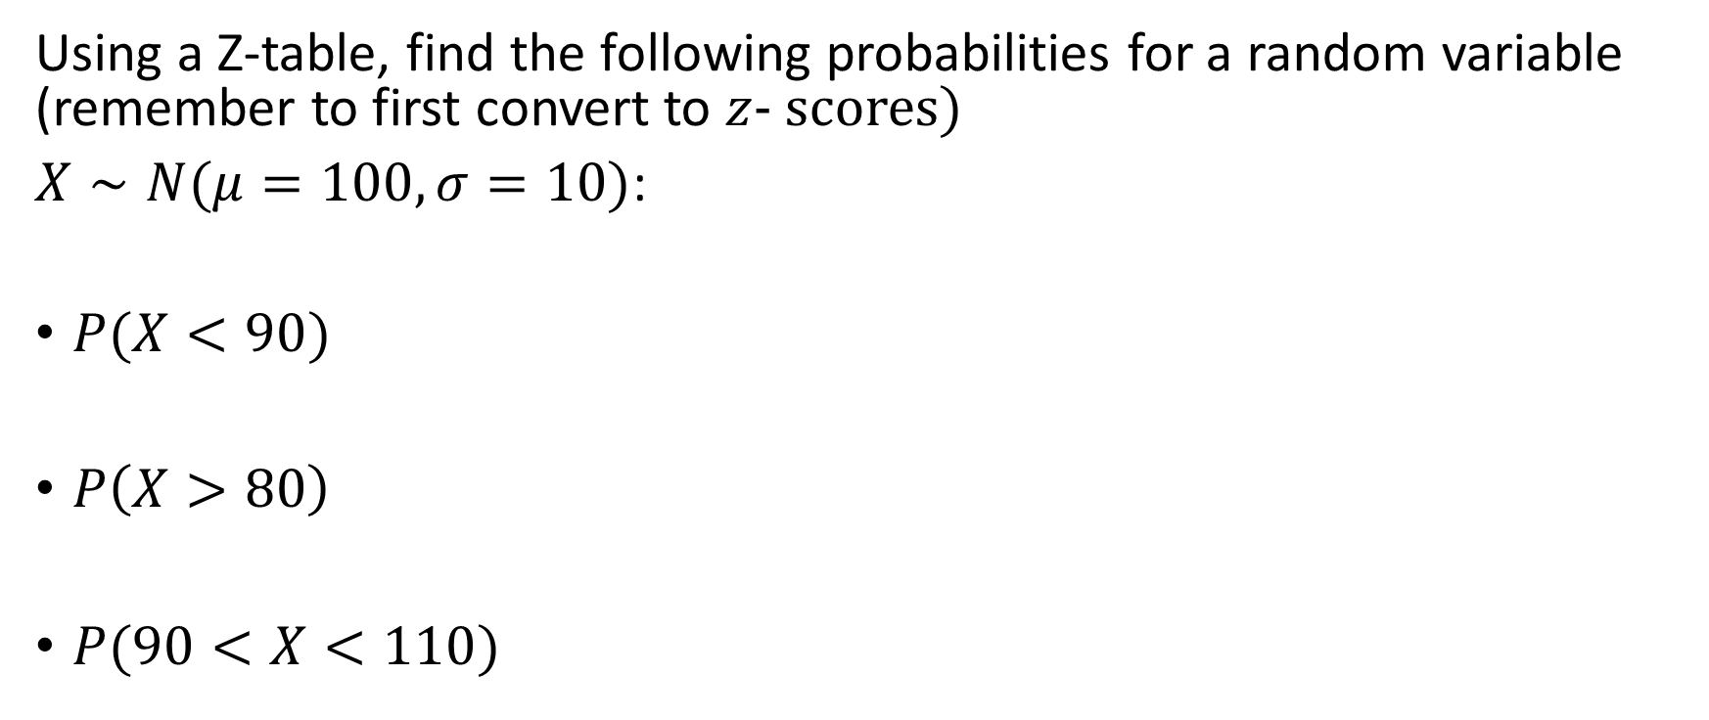
Examples:
Using a Z-table, find the following probabilities for a random variable (remember to first convert to $z$- scores)
$X∼N(μ=100,σ=10)$:
$P(X<90)$
$P\left(X>80\right)$
$P(90<X<110)$

Slide 16
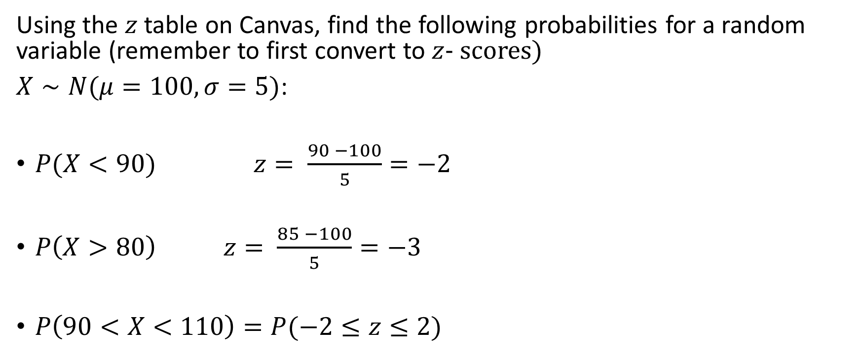
Examples:
Using the $z$ table on Canvas, find the following probabilities for a random variable (remember to first convert to $z$- scores)
$X∼N(μ=100,σ=5)$:
$P(X<90)$ $z= \frac{90 −100}{5}=−2$
$P\left(X>80\right)$ $z= \frac{85 −100}{5}=−3$
$P\left(90<X<110\right)=P(−2≤z≤2)$

